Slide 1
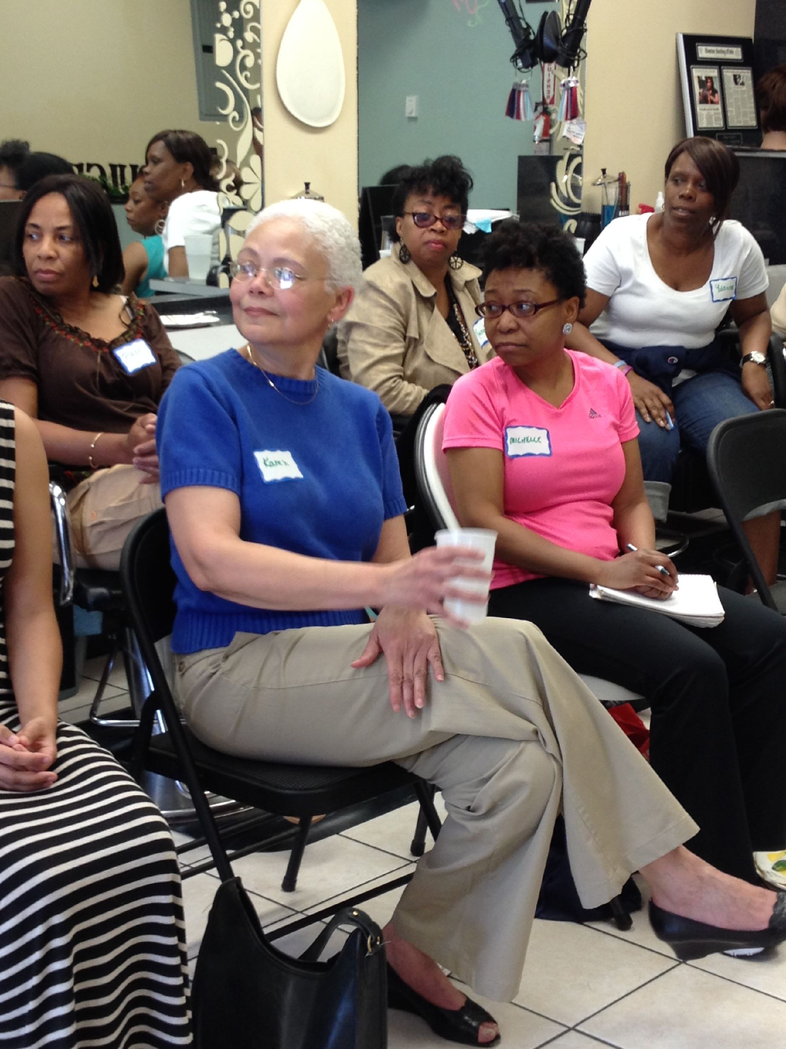
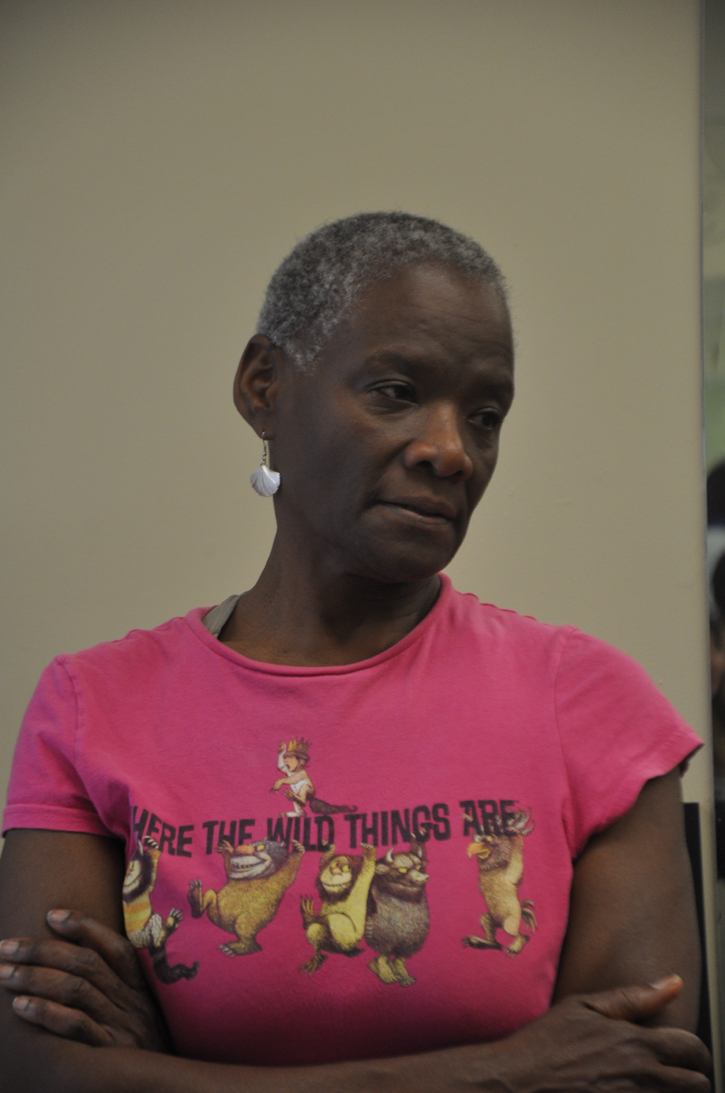
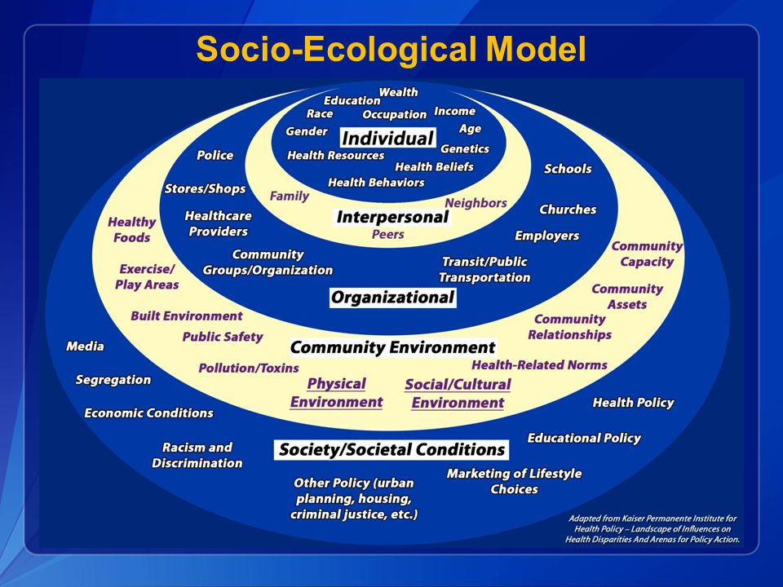
COMMUNITY CONVERSATIONS’ MODEL OF SOCIAL INCLUSION:
A CATALYST for TRANSFORMING FRAMEWORKS for BLACK WOMEN DELIVERING HEALTHCARE?
Community Conversations: Sister to Sister Program Evaluation
Dita Obler, MS, LCGC¹, Robin Reed, MD², Keri Griffin, PhD, MPH, MPA, MCHES³, Audra Meadows, MD, MPH⁴, Cheryl Clark, MD, ScD⁴, Yvette Cozier, DSc, MPH⁵, Linda Sprague-Martinez, PhD⁶, Omolade Sogade, BA, MD Candidate ⁷
¹ Community Conversations: Sister to Sister Women's Health Initiative, Cambridge, MA, ² Tufts University School of Medicine, Boston, MA, ³ MCPHS University, Boston, MA, ⁴ Brigham and Women's Hospital, Boston, MA, ⁵ Slone Epidemiology Center at Boston University, Boston, MA, ⁶ Boston University, Boston, MA, ⁷ Washington University School of Medicine
BACKGROUND
OBJECTIVES
RESULTS & DISCUSSION
Since 2009, Community Conversations Sister to Sister (CC) Women’s Health Initiative has aimed to establish a “health community” that (1) empowers black women as healthcare consumers and (2) addresses barriers to improved health outcomes, thereby eliminating health disparities. CC has connected over 320 women to over 180 healthcare professionals through monthly conversation in a local beauty salon.
CC builds on the profound conversations occurring daily at hair salons in the black community bringing together key community & professional stakeholders on common, neutral ground for facilitated conversation. Each conversation focuses on a health topic crafted to address an area where the community has been poorly/under-served and include an exploration of racial, ethnic and gender disparities in health data as well as access to and provision of, appropriate, quality health care. Conversations probe how a longstanding and mistrustful history between the black community and the medical/scientific communities has led to significant barriers in access to health related information and utilization of appropriate, high quality healthcare resources.
The essential elements of the CC model and health community are social inclusion, facilitated discussions, and health system navigation training. CC has shown success in this model as evidenced by previously reported qualitative data highlighting its value to women in the community. Women report feeling empowered to become actively involved in improving and maintaining their personal and family health, increased experience of health literacy and self-efficacy, and improvement in skills of shared-decision making and partnering with care providers.
Social inclusion recognizes the human need to give and receive social support and engage fully in society. The antithesis of which is social exclusion, a social determinant of health resulting from structural racism, discrimination, and societal factors. Social exclusion has been linked to adverse health status and disparities. The current study explores:
Black women healthcare providers’ experiences of belonging and inclusion as a part of the CC health community
As a part of the current examination, we also assessed the extent to which there was an association between social inclusion and the Community Conversations model to enhance the approach of black women healthcare providers to
I. Patient Care
II. Practice-level/Hospital Systems Care Delivery
III. State-level Health Policy Initiatives
Patient Care Outcomes
In the sample, 96% of CC providers agreed that CC provides unique opportunities for reciprocal learning (e.g. gain a broader understanding of patient experiences and vulnerability toward their providers, better understand some of the challenges faced by their study participants).
In their own words:
“Participating in CC reminds me to facilitate conversations with my patients rather than being didactic.”
“As an MD, I have gained more insight of the obstacles patients face.”
“On the panel, I served both as a care provider as well as someone [with] a family member with the same health condition, so it was both professional and personal. I could truly relate to the circumstances.
“When I see CC topics in email announcements, like “Building a Grief Toolkit” -- that little buzz has been put in my ear and I’ll bring up that topic with my patients.”
“As a result of attending CC forums, I entered a Health Study that I have been a part of for the past 4 years. I have recruited several of my friends and family to get involved with the study and they feel proud to serve our culture in this important and significant way--all thanks to my experiences with CC.”
METHODS
CC COMMUNITY
Develop Mixed Methods, Online Survey & Obtain Approval from IRB
Develop research strategy and methods for effective evaluation of impact of social inclusion on attitudes/experience of CC Faculty
Provide appropriate protection of vulnerable research population
Identify & partner w/ established IRB to ensure human subjects protection
Develop and pilot research instruments (2 semi-structured interview protocols and online survey) and consent documentation
Recruit faculty to mentor qualitative and mixed methods research
Recruit & train research interns, obtain CITI/NIH human research subjects certification
Recruit research subjects (10 community participants & 10 healthcare providers)
Data Collection
Qualitative: Conduct N = 20 in-depth semi-structured interviews to assess impact of CC on health self-efficacy and behaviors among healthcare consumers and providers. Previously reported
Mixed Methods: Using Qualtrics tool, developed and administered online survey to N = 77 CC constituency triaged to role(s) in CC participation (Community members n = 45, and Faculty Participant members n=32)
Data Analysis
Qualitative data: transcribe, anonymize and code interviews; analyze data to assess CC strengths and challenges
Mixed Methods data: code, analyze and conduct statistical analysis to identify factors contributing to experience of social inclusion and impact of CC on faculty’ attitudes and behaviors as change agents
Integrate and Disseminate Results
Incorporate learning to improve effectiveness of model
Identify opportunities for program expansion
Prepare report for distribution to community collaborators and partners
FOUNDERS
Practice-level/Hospital Systems Care Delivery
Of the providers assessed, 77% agreed that CC provides them with insight from community members to help address barriers and structural issues in their professional settings (e.g. practice groups, academic or clinical departments, hospitals, and healthcare systems). While just over half of these practitioners work in care settings that address the social determinants of health (55%--moderately, very, or extremely well), at least one provider remarked: “self-examination of healthcare activism should occur both for the provider as well as the patient”. Though many CC providers’ practice settings address the social determinants of health, only 52% responded that it would be comfortable to speak with their colleagues about health engagement as it relates to health disparities or barriers to care for people of color (somewhat easy or extremely easy).
In their own words:
“I am in the mental health field. It still is somewhat surprising the stigma still felt around therapy.” (Regarding barriers to accessing system-level care)
“CC reinforces my decision to offer prenatal group care as the benefit to women is evident every session.”
“We're making systems changes ... and that's wonderful but we're not making the community, individuals aware of all that is happening…It's going to take some time. But hopefully we're making changes.”
“When you think about the resources available to help manage or improve (health) conditions ... resources not only health institutions but communities... access to food, the environment, to transportation, to social supports, all of those are things that really help people improve quality of life. It's not just the right meds but also all those other pieces. And a community that can build that can help.”
FACULTY
INTERNS
STEERING
COMMITTEE
STRATEGIC
PLANNING
CONSUMERS
CC MODEL
State-level Health Policy Initiatives
Strikingly, the overwhelming majority of providers indicated that targeting personal behavior change was the highest priority health improvement area for healthcare activism (32%), followed by family-level decision making (48%). Very few of the providers indicated that the appropriate targets for healthcare activism lay at the system, state, or federal policy levels. These findings indicate the providers’ focus on conveying the concepts of self-efficacy and personal agency in making healthcare decisions. This perhaps leaves room for targeting focused discussion regarding the potential positive impacts of systems-level and policy change.
In their own words:
“…It has to change on a societal level. The priorities of our society have to change ...it’s easier to get a gun than a well-balanced meal at your table.”
CC promotes individual and collective efficacy by curating a safe space for ongoing bi-directional dialogue that allows women to share knowledge and experience, identify opportunities for empowerment, and practice partnering with health professionals thus replacing more conventional, hierarchical models for health information exchange (where professionals deliver healthcare information to consumers without opportunities for bilateral engagement and mutual learning). As suggested by Bandura’s model of Triadic Reciprocal Determinism, CC recognizes and builds on the powerful relationship between behavioral, personal and environmental factors. The CC community leadership, in collaboration with community participants, selects the health topics to be discussed throughout the year. By engaging in the selection of topics, participants gain an understanding of the risk factors for diseases and the effectiveness of recommended health behaviors. According to the Health Belief Model, this increases rates of adoption of health behaviors.
RESULTS & DISCUSSION
CC Providers were asked to comment on factors that affect their sense of belonging and inclusion in a community:
Over half (53%) of providers assessed felt that sameness/shared experiences/a shared world view was the top factor. Other factors agreed upon that conveyed a sense of belongingness: 1) being valued and embraced, 2) having a sense of a shared mission.
Being a part of the CC health community: Providers who responded indicated that they felt comfortable as members of CC (extremely: 54.2%; somewhat: 25%) which was greater than their levels of comfort where they live (74%), work (75%), or attend religious services (50%). Further, none indicated that they had difficulty setting aside their professional roles and sharing personal details about their or their family’s experiences.
Thoughts about Participating in Community Conversations in their own words:
“Since I did not have a community of friends who were experiencing what I was going through, that is who expressed concern for things that were going on in my life, I welcomed the opportunity to voice my experiences with a group of women who were offering a forum for this kind of exchange.”
“I spend a majority of my time in predominantly white spaces for school, work, church, and even in fitness groups-so when CC was presented to me it sounded like the promise of a breath of a fresh air, and four years later – it remains as such.”
“CC’s been really important. Moving to Boston, I had a hard time finding a community. Connected to CC maybe a year or two after; It opens me up.”
“[As a health professional], I can see a woman of color finding herself isolated and lonely. I’ve been really pleased that CC has created a way for professional women of color in healthcare to come together and meet each other.”
REFERENCES
Bandura, A. (1977). Social learning theory. Englewood Cliffs, NJ: Prentice Hall.
Begen, F.M. & Turner-Cobb, J.M. (2015). Benefits of belonging: experimental manipulation of social inclusion to enhance psychological and physiological health parameters. Psychology & Health, 30:568-582.
Dean, L (2014). The role of social capital in African-American women’s use of mammography, Social Science & Medicine 148-156.
Floyd, K. Veksler, A.E., McEwan B., Hesse, C., Boren, J.Pj, Dinsmore, D.R., & Pavlich, C.A. (2016). Social inclusion predicts lower blood glucose and low-density lipoproteins in healthy adults. Health Communication 27:1-4 Epub ahead of print.
Hagerty, B.M., & Williams, A. R. (1999). The effects of sense of belonging, social support, conflict, and loneliness on depression. Nursing Research 48:215-219.
McLeroy, K.R. (1988). An Ecological Perspective on Health Promotion Programs. Health Education Quarterly. 15(4).
Walton, G.M., & Lawrence, G. (2011). A brief social-belonging intervention improves academic and health outcomes of minority students. Science. 331:1447-1451
www.ccsister2sister.org
Bandura, A. (1977). Social learning theory. Englewood Cliffs, NJ: Prentice Hall.
McLeroy, K.R. (1988). An Ecological Perspective on Health Promotion Programs. Health Education Quarterly. 15(4).

